Slide 1
Introduction to Power BI Part 1
Data Analytics – BMG 880
Dr Hakim Mezali

Slide 2

Quote
“When people think about data analytics, data science, machine learning and artificial intelligence, the talk turns almost immediately to tools, things like programming languages and sophisticated computer setups. But remember the tools are simply a means to an end. And even then only part of it, the most important part of any data analytics project by far is the question itself and the creativity that comes in exploring that question and working to find possible answers using the tools that best match your questions”

Slide 3

Applications for Data Analysis
By far, the most common application for data work is going to be the humble spreadsheet. And there are a few reasons why this should be the case. Number one,
Spreadsheets the universal data tool (Microsoft Excel, and it's in many versions).
There are more datasets in spreadsheets than in any other format in the world.
The rows and columns are very familiar to a very large number of people, and they know how to explore the data and access it using those tools.
Google Sheets is also extremely common and there are others.
The great thing about spreadsheets is they're good for browsing.
Any program in the world can read a CSV file, a comma separated values, which is the generic version of a spreadsheet.
Notes:
And sometimes those tools are simple ones. It's good to remember, even in data science, that we should start with the simple and not move on to the complicated until it's necessary. And for that reason, I suggest that we start with data science applications. And so you may wonder why apps? Well, number one, they're more common. They're generally more accessible, more people are able to use them. . They're often very good for exploring the data, browsing the data, and they can be very good for sharing. Again, because so many people have them and know how to use them

Slide 4
Applications for Data Analysis
Another very common data tool, even though it's not really an application, but a language is SQL, which stands for structured query language.
This is a way of accessing data stored in databases, usually relational databases, where you select the data, you specify the criteria you want.
You can combine it and reformat it in ways that best work. You only need maybe a dozen or so commands in SQL to accomplish the majority of tasks that you need.
So a little bit of familiarity with SQL is going to go a very long way.

Slide 5

Applications for Data Analysis
And then there are the dedicated apps for visualization. That includes things like Power BI, Tableau, both the desktop and the public and the server version and Qlik.
What these do is they facilitate data integration. That's one of their great things.
They bring in data from lots of different sources and formats and put it together in a pretty seamless way.
And they allow you, their purpose is interactive data exploration to click on sub groups, to drill down, to expand what you have. And they're very, very good at that.

Slide 6
Applications for Data Analysis
And then there are apps for data analysis. So these are applications that are specifically designed for point-and-click data analysis.
Data scientists think that coding is always better at everything, but the point-and-click graphical user interface makes things accessible to a very large number of people.
This includes common programs like IBM SPSS, or JASP, or my personal favourite Jamovi.
JASP and Jamovi are both free and open source. And what they do is they make the analysis friendly.
But whatever you do, just remember to stay focused on your question and let the tools and the techniques follow your question.
Start simple with the basic applications and move on only as the question requires it. That way you can be sure to find the meaning and the value as you uncover it in your data.

Slide 7
Overview Power BI
In Feb 2019 Microsoft was named as the leader in the Gartner Magic Quadrant for Analytics and Business Intelligence not for the first time, but for the 12th year in a row,
For the past five years, Microsoft's pre-eminence in analytics and business intelligence is because of Microsoft Power BI.
Power BI is a set of powerful tools designed to be accessible to business end users, tools that let you create visualizations that you can manipulate, publish, and share with your colleagues.
Learning Power BI gives you an edge over people who are trying to analyze data using tools that are harder to use, less powerful, and less collaborative.
Let’s explore using Power BI to make a positive impact for you, your team, and your organization.

Slide 8

What you need for this course
Here is what you will need if you want to work along with the demonstrations in this course.

Slide 9
Recommended Hardware
Available RAM: 1.5 GB or more recommended (1 GB minimum)
CPU 1 GHz or faster x86 – or x64-bit processor
Display setting: 1440x900 0r 1600x900
Display setting for text: 100% or less

Slide 10
Recommended Software
Windows 7/Windows server 2008 R2 or later
.NET 4.5
Latest Browser (Edge, Chrome, Internet Explorer…)
Power BI Pro or Power BI
Power BI Desktop

Slide 11
Data Skills
We have developed these criteria in the first five weeks.
Visualization of data and sharing these data
Enter, edit, and format text and number
Table command
Find and replace
Sort and filter
Insert and format charts
Etc…

Slide 12
Power BI Concepts

Slide 13

Power BI - Business Intelligence
Microsoft Power BI is an interactive data visualization software product developed by Microsoft with a primary focus on business intelligence. It is part of the Microsoft Power Platform
A simple understanding of business intelligence is that business intelligence is about connecting business decision-making to facts about the business and its environment,
to take a deep dive and understand the data underneath your business, so that you can make better business decisions.

Slide 14
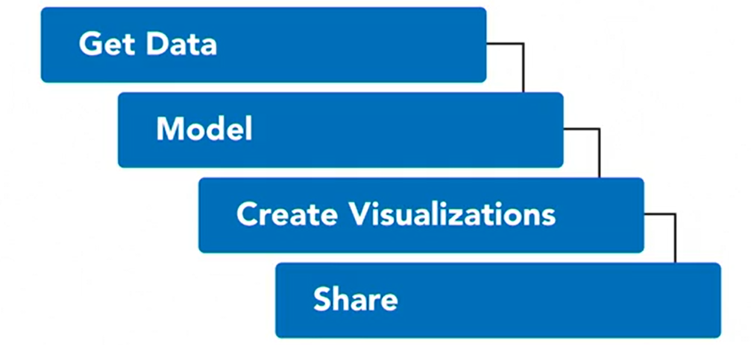
Business Intelligence

Slide 15
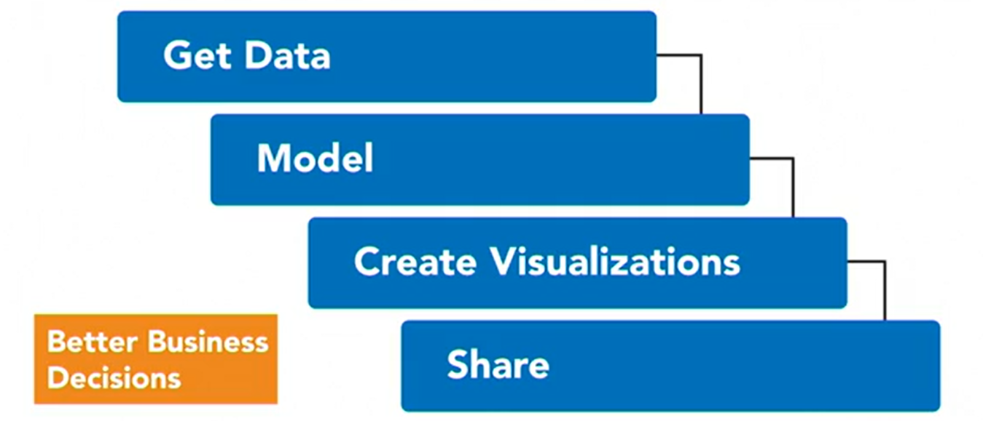
Business Intelligence

Slide 16
Enterprise Business Intelligence BI
SAP
Oracle
IBM
Microsoft
SAP BusinessObjects Business Intelligence is a centralised suite for data reporting, visualisation, and sharing
Oracle Analytics Empowers Business Users To Connect, Prepare And Enrich All Relevant Data. Use One Platform For Connecting To Any Data Source, Preparing It, And Visualising It.
IBM Cognos Business Intelligence is a web-based integrated business intelligence suite by IBM. It provides a toolset for reporting, analytics, scorecarding, and monitoring of events and metrics
Microsoft Power BI is an interactive data visualization software product developed by Microsoft with a primary focus on business intelligence

Slide 17


Enterprise Business Intelligence BI
Tableau Is Business Intelligence Software That Helps People See and Understand Their Data.
The company's main products are Qlik Replicate and Qlik Sense, both software for business intelligence and data integration.

Slide 18
Microsoft Power BI
Datasets
Reports
Dashboards
Microsoft Power BI is an interactive data visualization software product developed by Microsoft with a primary focus on business intelligence
Power BI provides cloud-based BI (business intelligence) services, known as "Power BI Services", along with a desktop-based interface, called "Power BI Desktop". It offers data preparation, data discovery, and interactive dashboards.

Slide 19
Power BI Components
Power BI Service: powerbi.com or Power BI (It is a web base to do a business information)
1
Power BI Desktop (free download)
2
Power BI visuals marketplace
3
Power BI mobile apps (IOS, Android and Windows)
4
Power BI gateway
5
Power BI embedded
6
Power BI report server
7

Slide 20
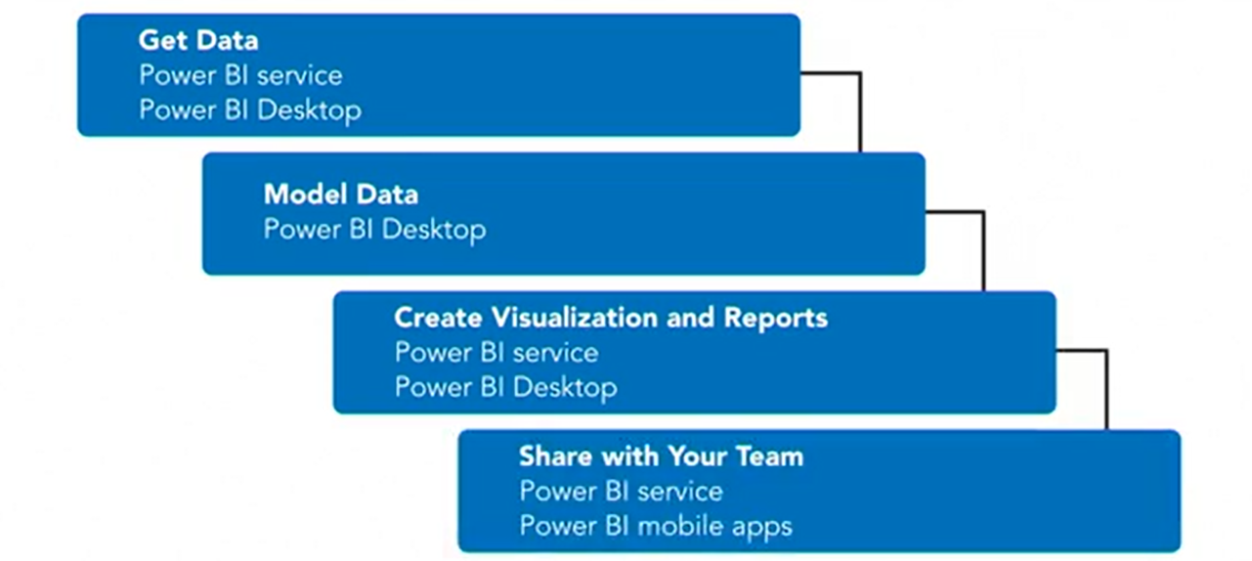
Power BI Tools

Slide 21

Sign Up for Power BI

Slide 22
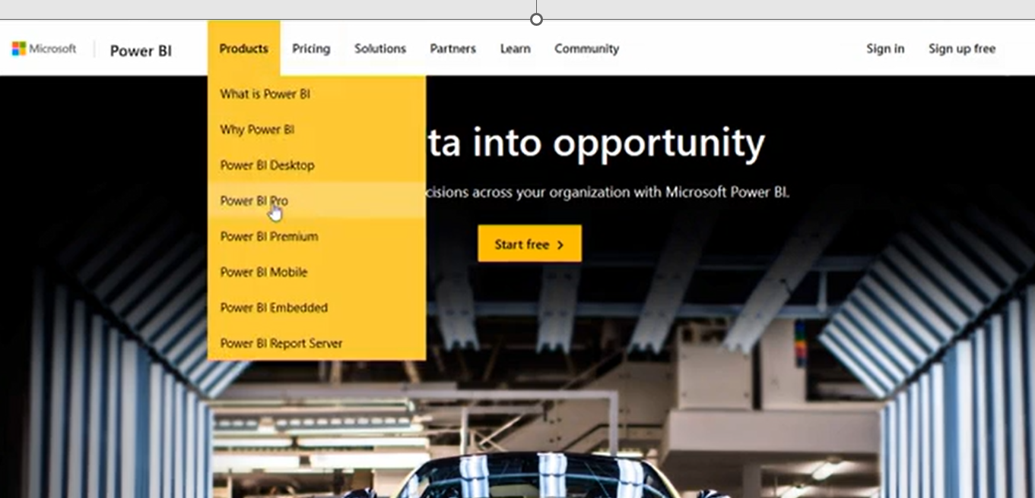
Sign Up for Power BI

Slide 23
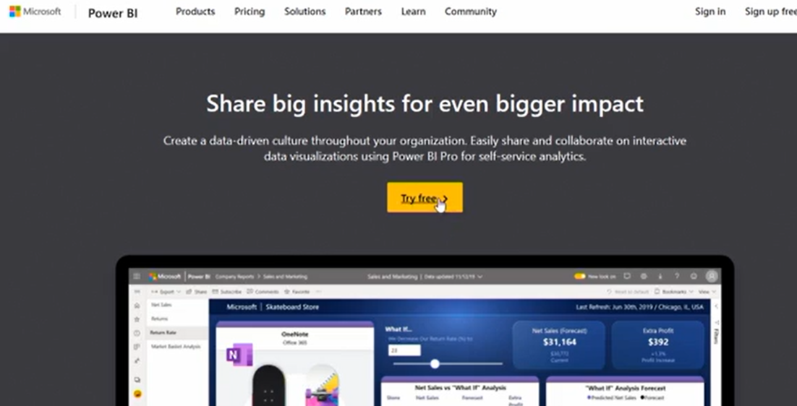
Sign Up for Power BI

Slide 24
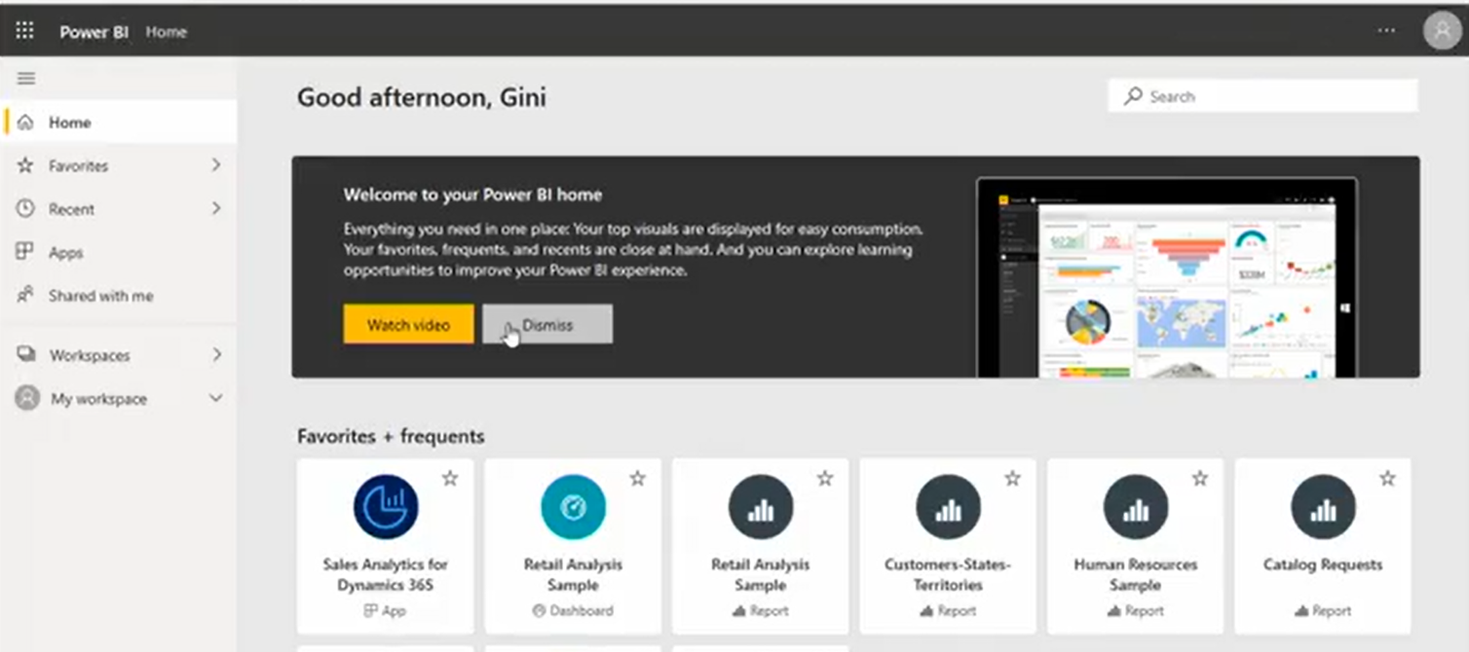
Sign Up for Power BI

Slide 25
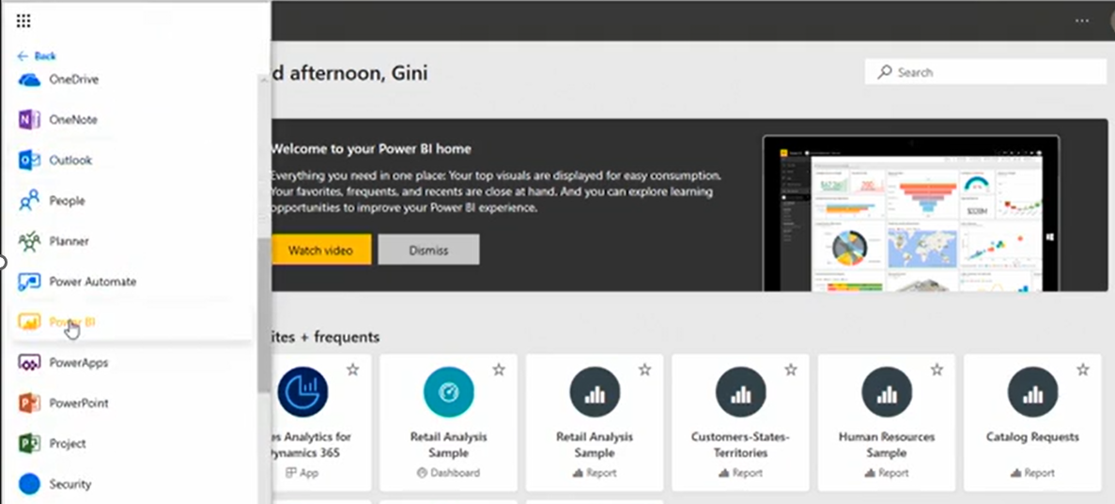
Sign Up for Power BI

Slide 26

Question?

